Slide 1
Lecture 17: Logistic Regression II

Slide 2
Lecture Outline
Interpreting interactions in logistic regression
Classification Boundaries
Regularization in Logistic Regression
Bayes Theorem and Misclassification Rates
ROC Curves

Slide 3
Interactions in Multiple Logistic Regression
Just like in linear regression, interaction terms can be considered in logistic regression. An interaction terms is incorporated into the model the same way, and the interpretation is very similar (on the log-odds scale of the response of course).
Write down the model for the Heart data for the 2 predictors plus the interactions term based on the output on the next slide.

Slide 4
Interpreting Multiple Logistic Regression: an Example
The results for the multiple logistic regression model are:

Slide 5
Some questions
Write down the complete model. Break this down into the model to predict log-odds of heart disease (HD) based on Age for women and the same model for men.

Slide 6
Some questions
Interpret the results of this model. What does the coefficient for the interaction term represent?
Estimate the odds ratio of HD comparing men to women using this model [trick question].

Slide 7
Classification Boundaries

Slide 8
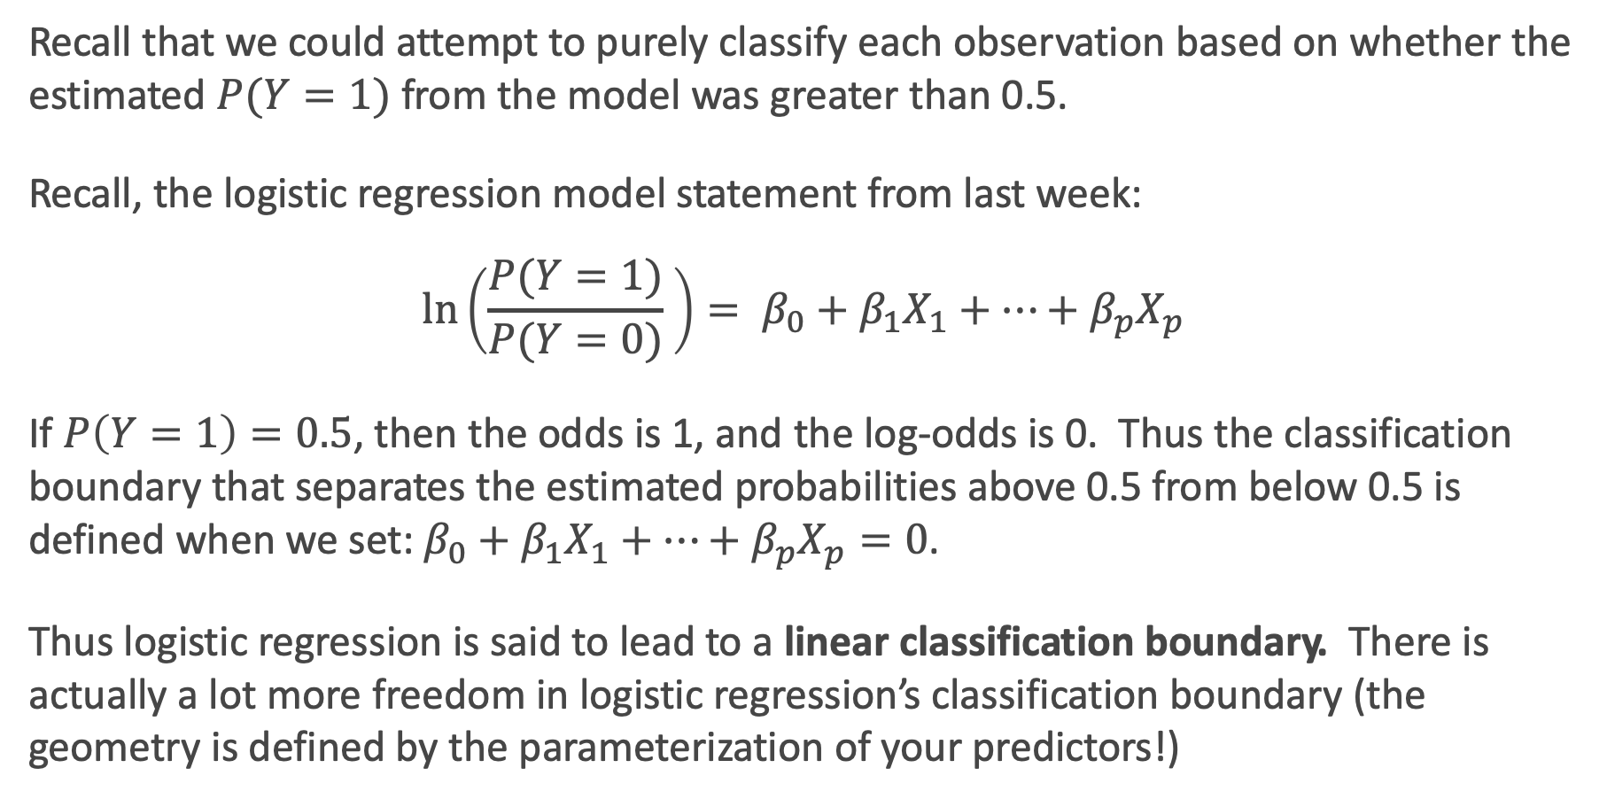
Classification boundaries
Recall that we could attempt to purely classify each observation based on whether the estimated $P(Y=1)$ from the model was greater than 0.5.
Recall, the logistic regression model statement from last week:
$$\ln\left(\frac{P(Y=1)}{P(Y=0)} \right)= β_{0}+β_{1}X_{1}+…+β_{p}X_{p}$$
If $P\left(Y=1\right)=0.5$, then the odds is 1, and the log-odds is 0. Thus the classification boundary that separates the estimated probabilities above 0.5 from below 0.5 is defined when we set: $β_{0}+β_{1}X_{1}+…+β_{p}X_{p}=0$.
Thus logistic regression is said to lead to a linear classification boundary. There is actually a lot more freedom in logistic regression’s classification boundary (the geometry is defined by the parameterization of your predictors!)

Slide 9
Linear Classification Boundary Example

Slide 10
Classification Boundary: a complicated example
Using the results of the model above, at what ages will males be predicted to have a heart attack in a classification? At what ages will females be predicted to have a heart attack?

Slide 11
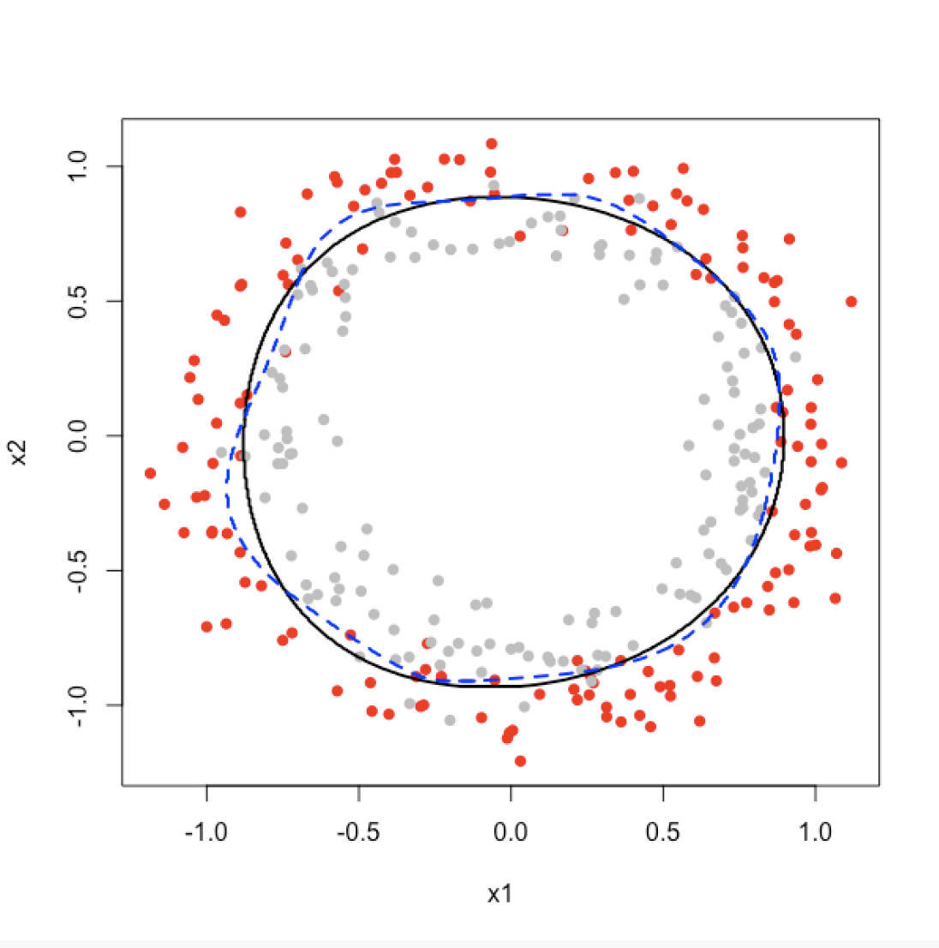
Geometry of 2D Classification in Logistic Regression: an Example

Slide 12
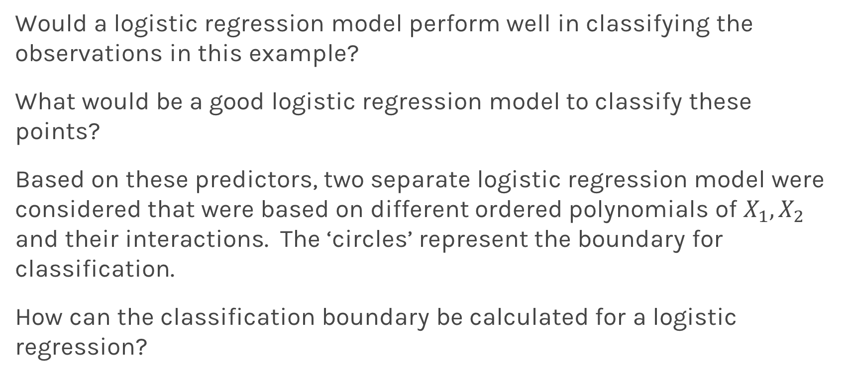
2D Classification in Logistic Regression: an Example
Would a logistic regression model perform well in classifying the observations in this example?
What would be a good logistic regression model to classify these points?
Based on these predictors, two separate logistic regression model were considered that were based on different ordered polynomials of $X_{1},X_{2}$ and their interactions. The ‘circles’ represent the boundary for classification.
How can the classification boundary be calculated for a logistic regression?

Slide 13
Regularization in Logistic Regression

Slide 14
Review: Regularization in Linear Regression
Based on the Likelihood framework, a loss function can be determined based on the log-likelihood function.
We saw in linear regression that maximizing the log-likelihood is equivalent to minimizing the sum of squares error:

Slide 15
Review: Regularization in Linear Regression
And a regularization approach was to add a penalty factor to this equation. Which for Ridge Regression becomes:
Note: this penalty shrinks the estimates towards zero, and had the analogue of using a Normal prior centered at zero in the Bayesian paradigm.

Slide 16

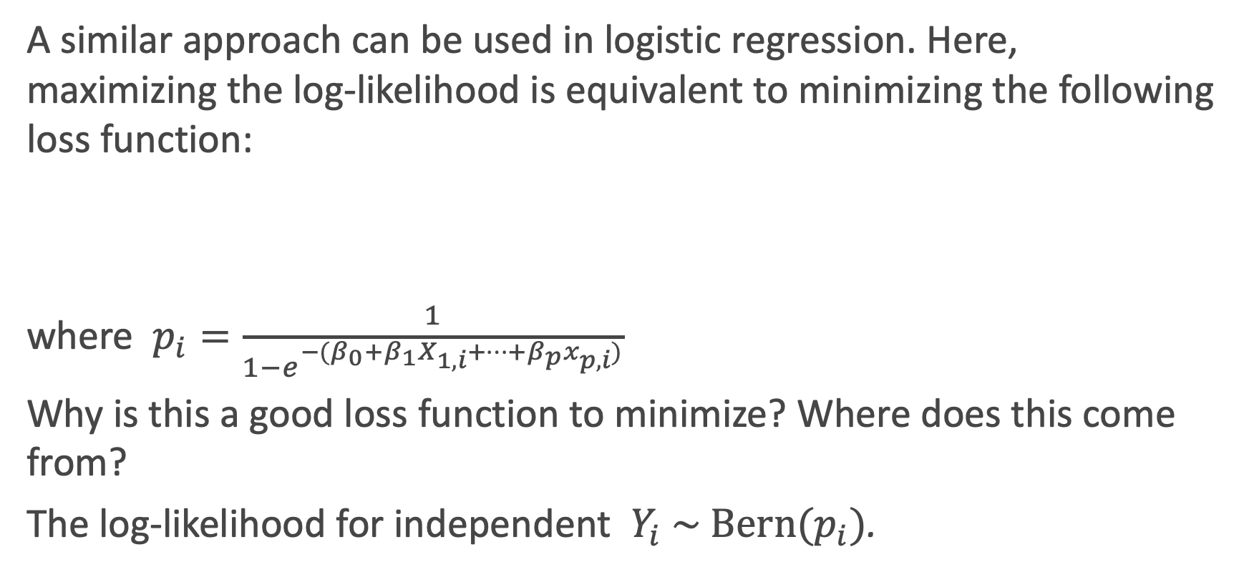
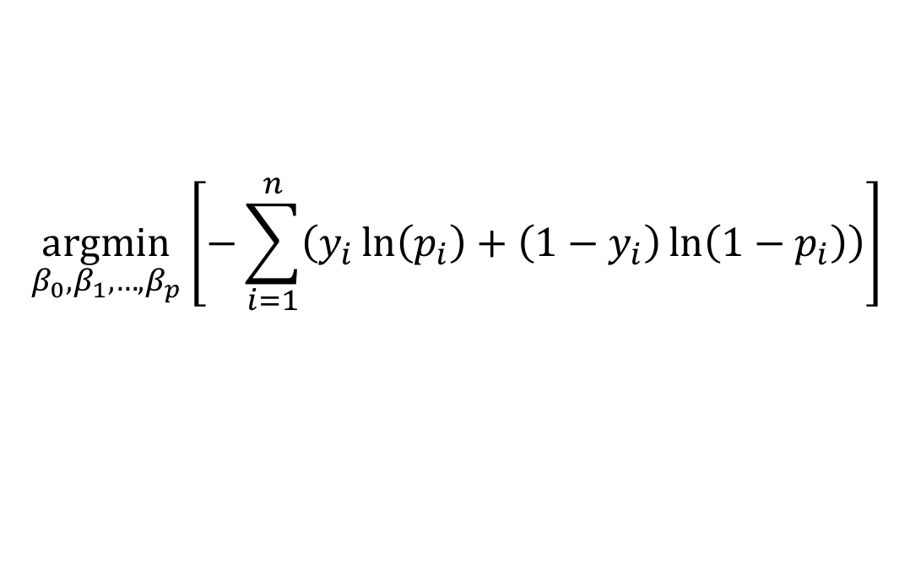
Recall: Loss function in Logistic Regression
A similar approach can be used in logistic regression. Here, maximizing the log-likelihood is equivalent to minimizing the following loss function:
where $p_{i}=\frac{1}{1−e^{−(β_{0}+β_{1}X_{1,i}+…+β_{p}x_{p,i})}}$
Why is this a good loss function to minimize? Where does this come from?
The log-likelihood for independent $Y_{i} \sim \text{Bern}(p_{i})$.
$$\underset{β_{0},β_{1},…,β_{p}}{argmin}⁡\left[−\sum_{i=1}^{n}{\left(y_{i}\ln\left(p_{i}\right)+\left(1−y_{i}\right)\ln\left(1−p_{i}\right)\right)}\right]$$

Slide 17
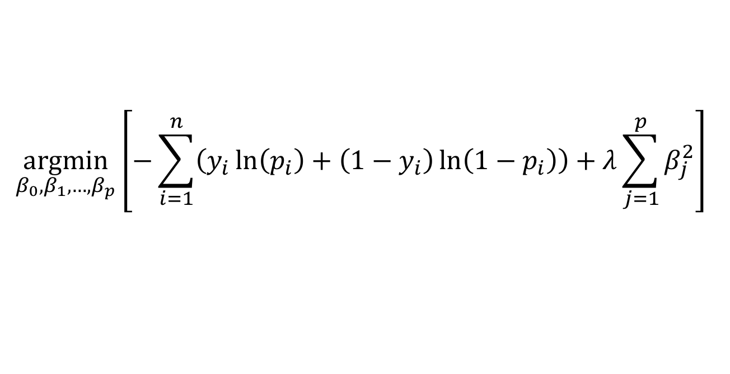
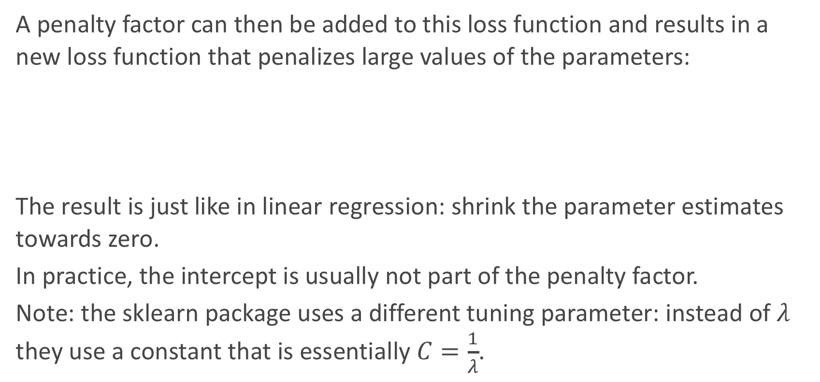
Regularization in Logistic Regression
A penalty factor can then be added to this loss function and results in a new loss function that penalizes large values of the parameters:
The result is just like in linear regression: shrink the parameter estimates towards zero.
In practice, the intercept is usually not part of the penalty factor.
Note: the sklearn package uses a different tuning parameter: instead of $λ$ they use a constant that is essentially $C=\frac{1}{λ}$.
$$\underset{β_{0},β_{1},…,β_{p}}{argmin}⁡\left[−\sum_{i=1}^{n}{\left(y_{i}\ln\left(p_{i}\right)+\left(1−y_{i}\right)\ln\left(1−p_{i}\right)\right)}+λ\sum_{j=1}^{p}{β_{j}^{2}}\right]$$

Slide 18
Regularization in Logistic Regression: an Example
Let’s see how this plays out in an example in logistic regression.

Slide 19
Regularization in Logistic Regression: tuning $λ$
Just like in linear regression, the shrinkage factor must be chosen. How should we go about doing this?
Through building multiple training and test sets (hooray, cross-validation!), we can select the best shrinkage factor to mimic out-of-sample prediction.
How could we measure how well each model fits the validation sets?
We could measure this based on some loss function (more coming later)!

Slide 20
Regularized Decision Boundaries

Slide 21
Bayes Theorem, Misclassification Rates, False Positives and Negatives

Slide 22
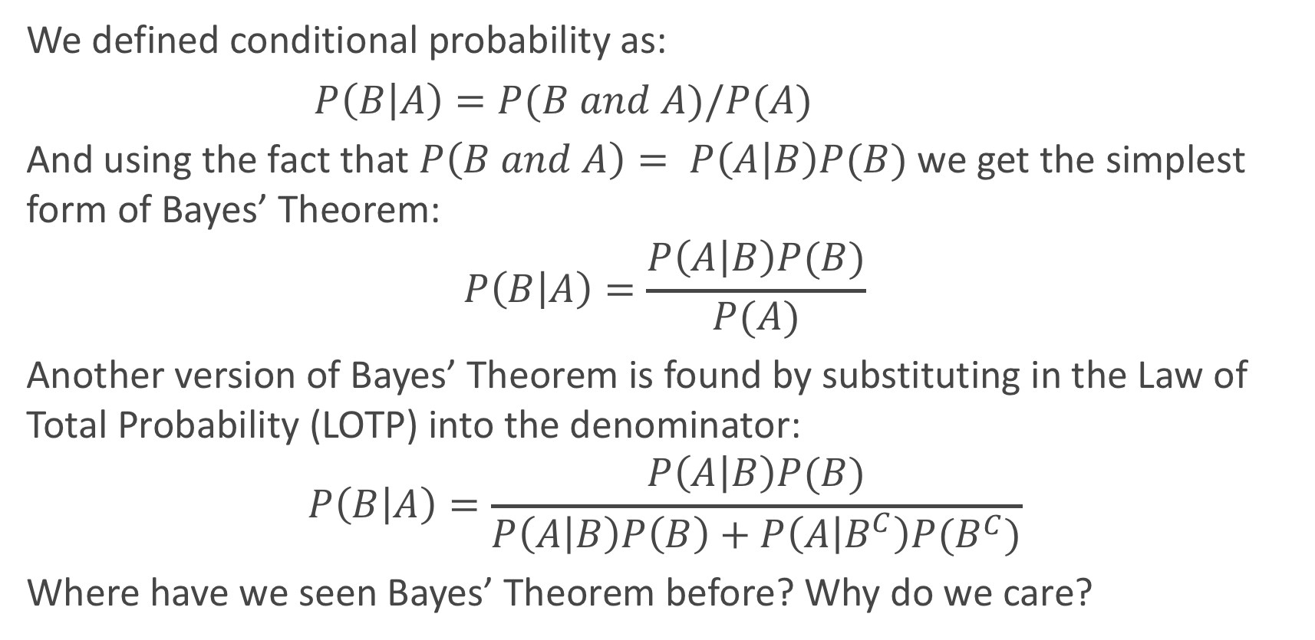
Bayes’ Theorem
We defined conditional probability as:
$P\left(B | A\right)=P(B and A)/P(A)$
And using the fact that $P\left(B and A\right)= P\left(A | B\right)P(B)$we get the simplest form of Bayes’ Theorem:
$$P\left(B | A\right)=\frac{P\left(A | B\right)P(B)}{P(A)}$$
Another version of Bayes’ Theorem is found by substituting in the Law of Total Probability (LOTP) into the denominator:
$$P\left(B | A\right)=\frac{P\left(A | B\right)P(B)}{P\left(A | B\right)P\left(B\right)+P\left(A | B^{C}\right)P(B^{C})}$$
Where have we seen Bayes’ Theorem before? Why do we care?

Slide 23
Diagnostic Testing
In the diagnostic testing paradigm, one cares about whether the results of a test (like a classification test) matches truth (the true class that observation belongs to). The simplest version of this is trying to detect disease (D+ vs. D−) based on a diagnostic test (T+ vs. T−).
Medical examples of this include various screening tests: breast cancer screening through (i) self-examination and (ii) mammography, prostate cancer screening through (iii) PSA tests, and Colo-rectal cancer through (iv) colonoscopies.
These tests are a little controversial because of poor predictive probability of the tests.

Slide 24
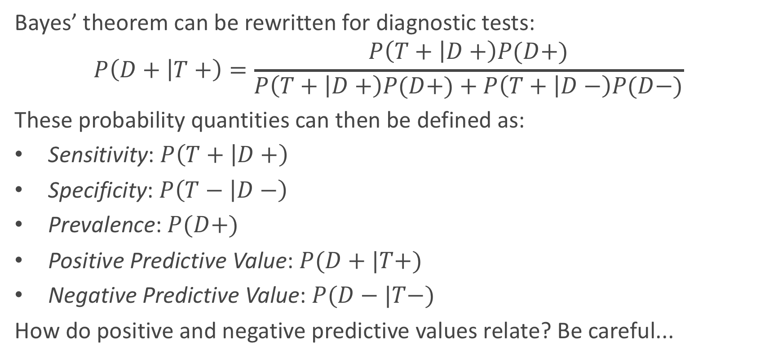
Diagnostic Testing (cont.)
Bayes’ theorem can be rewritten for diagnostic tests:
$$P\left(D+ | T+\right)=\frac{P\left(T+ | D+\right)P(D+)}{P\left(T+ | D+\right)P(D+)+P\left(T+ | D−\right)P(D−)}$$
These probability quantities can then be defined as:
Sensitivity: $P\left(T+ | D+\right)$
Specificity: $P\left(T− | D−\right)$
Prevalence: $P(D+)$
Positive Predictive Value: $P(D+|T+)$
Negative Predictive Value: $P(D−|T−)$
How do positive and negative predictive values relate? Be careful...

Slide 25
Diagnostic Testing
We mentioned that these tests are a little controversial because of their poor predictive probability. When will these tests have poor positive predictive probability?
When the disease is not very prevalent, then the number of ’false positives’ will overwhelm the number of true positive. For example, PSA screening for prostate cancer has sensitivity of about 90% and specificity of about 97% for some age groups (men in their fifties), but prevalence is about 0.1%.
What is positive predictive probability for this diagnostic test?

Slide 26
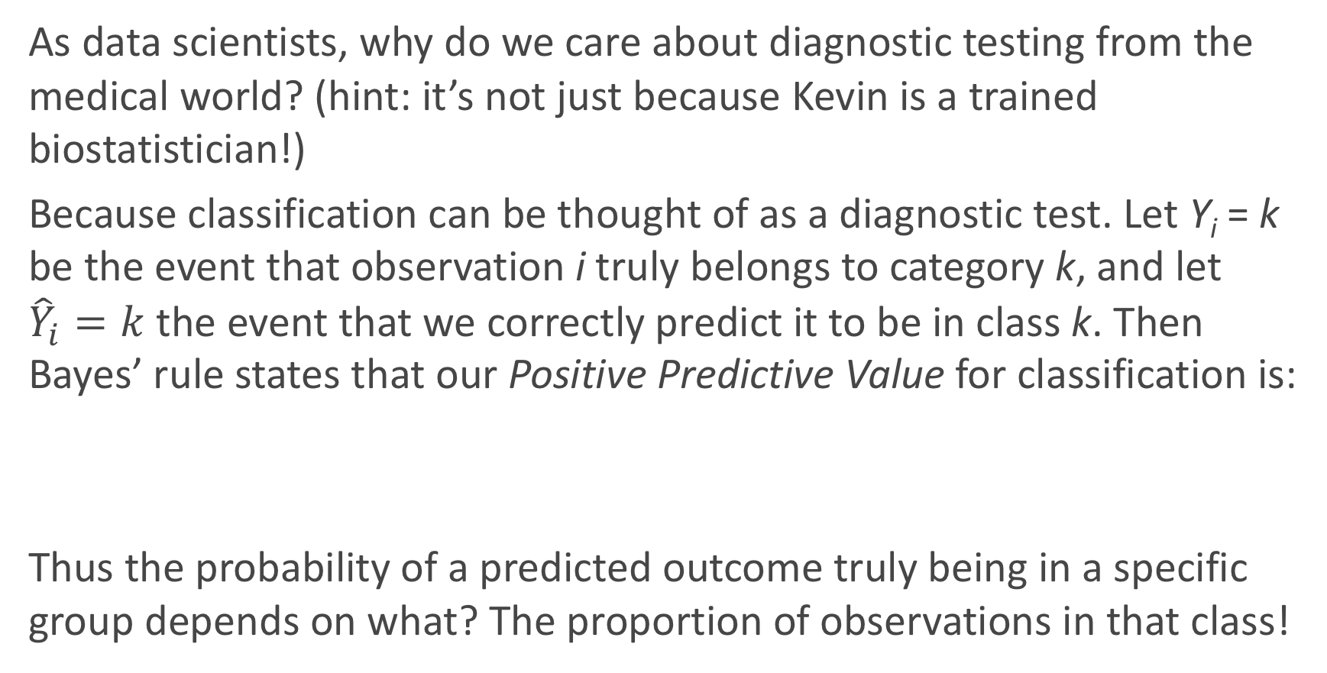
Why do we care?
As data scientists, why do we care about diagnostic testing from the medical world? (hint: it’s not just because Kevin is a trained biostatistician!)
Because classification can be thought of as a diagnostic test. Let Y_{i} = k be the event that observation i truly belongs to category k, and let ${\hat{Y}}_{i}=k$ the event that we correctly predict it to be in class k. Then Bayes’ rule states that our Positive Predictive Value for classification is:
Thus the probability of a predicted outcome truly being in a specific group depends on what? The proportion of observations in that class!

Slide 27
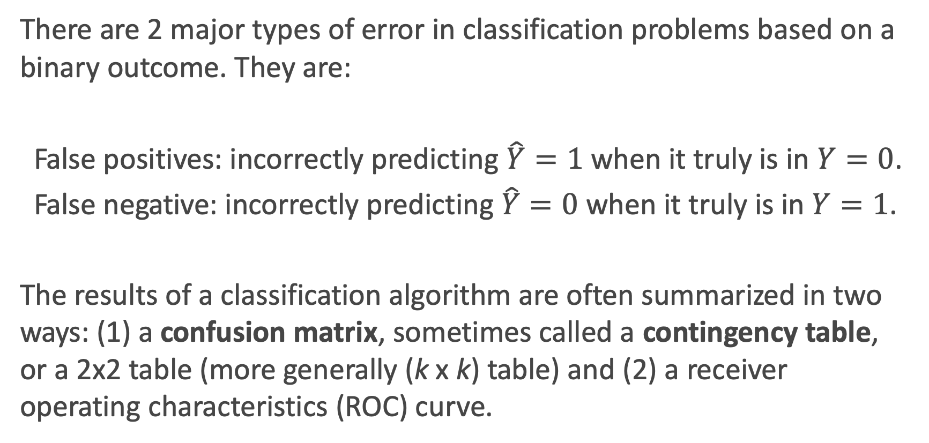
Error in Classification
There are 2 major types of error in classification problems based on a binary outcome. They are:
False positives: incorrectly predicting $\hat{Y}=1$ when it truly is in $Y=0$.
False negative: incorrectly predicting$\hat{Y}=0$ when it truly is in $Y=1$.
The results of a classification algorithm are often summarized in two ways: (1) a confusion matrix, sometimes called a contingency table, or a 2x2 table (more generally (k x k) table) and (2) a receiver operating characteristics (ROC) curve.

Slide 28
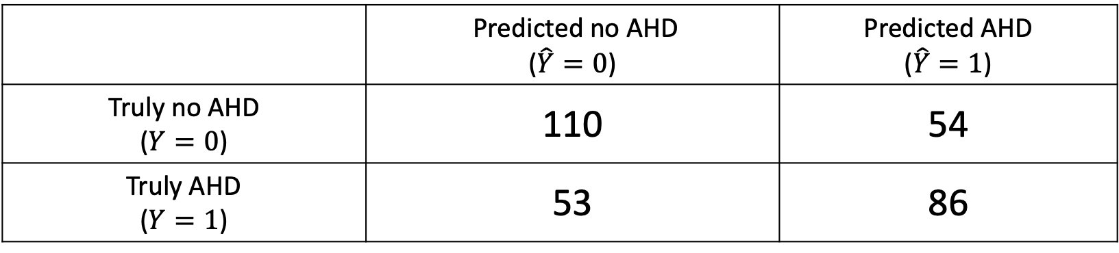
Confusion matrix
When a classification algorithm (like logistic regression) is used, the results can be summarize in a (k x k) table as such:
The table above was a classification based on a logistic regression model to predict AHD based on “3” predictors: X₁ = Age, X₂ = Sex, and X₃ = interaction between Age and Sex.
What are the false positive and false negative rates for this classifier?
 | Predicted no AHD ($\hat{Y}=0$) | Predicted AHD ($\hat{Y}=1$)
Truly no AHD ($Y=0$) | 110 | 54
Truly AHD ($Y=1$) | 53 | 86

Slide 29
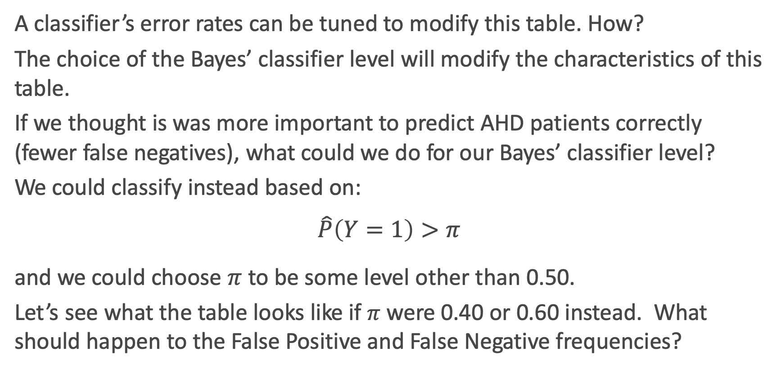
Bayes’ Classifier Choice
A classifier’s error rates can be tuned to modify this table. How?
The choice of the Bayes’ classifier level will modify the characteristics of this table.
If we thought is was more important to predict AHD patients correctly (fewer false negatives), what could we do for our Bayes’ classifier level?
We could classify instead based on:
$$\hat{P}\left(Y=1\right)>π$$
and we could choose $π$ to be some level other than 0.50.
Let’s see what the table looks like if $π$ were 0.40 or 0.60 instead. What should happen to the False Positive and False Negative frequencies?

Slide 30
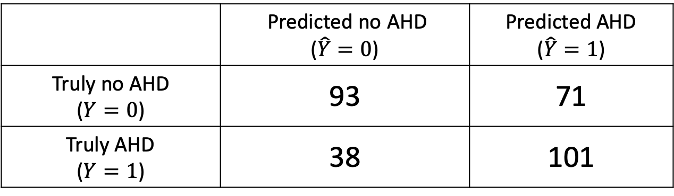
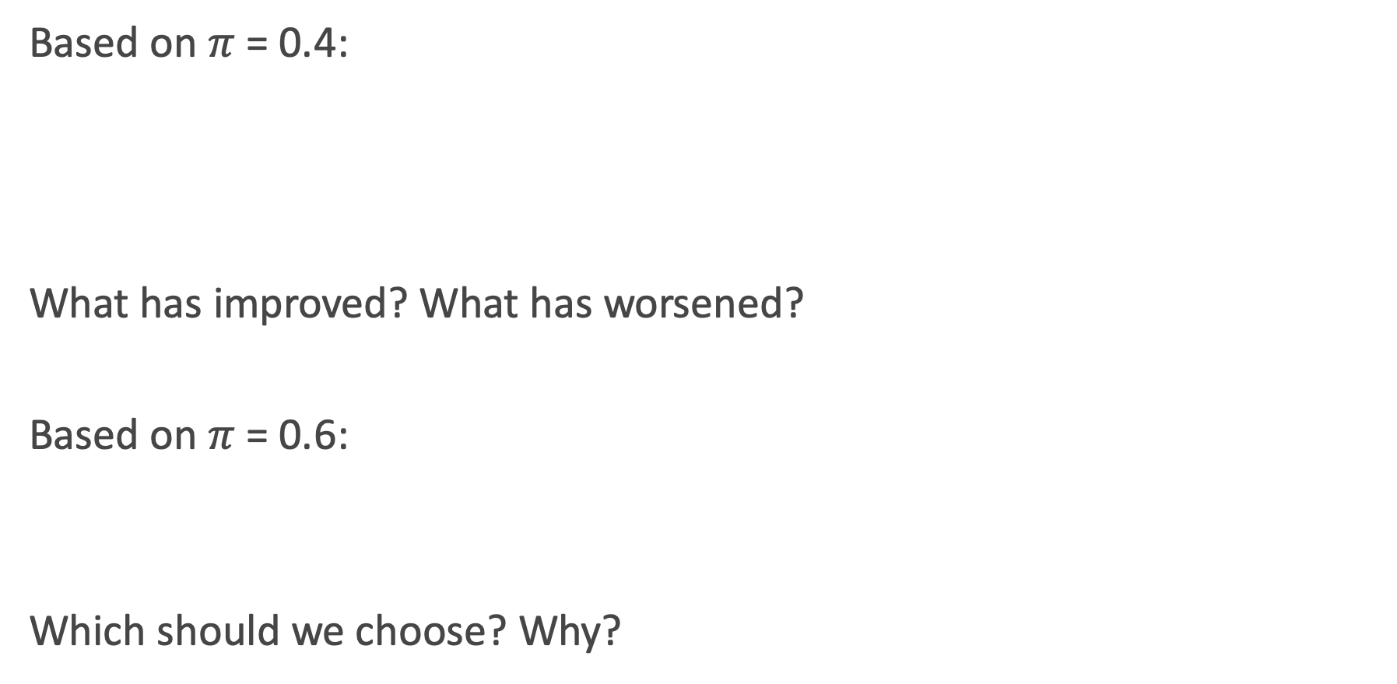
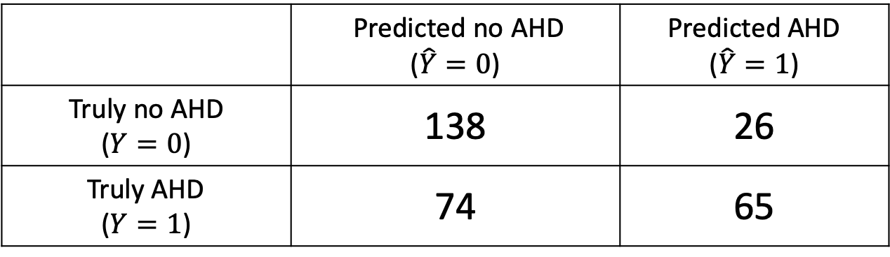
Other Confusion tables
Based on $π$ = 0.4:
What has improved? What has worsened?
Based on $π$ = 0.6:
Which should we choose? Why?
 | Predicted no AHD ($\hat{Y}=0$) | Predicted AHD ($\hat{Y}=1$)
Truly no AHD ($Y=0$) | 93 | 71
Truly AHD ($Y=1$) | 38 | 101
 | Predicted no AHD ($\hat{Y}=0$) | Predicted AHD ($\hat{Y}=1$)
Truly no AHD ($Y=0$) | 138 | 26
Truly AHD ($Y=1$) | 74 | 65

Slide 31
ROC Curves and Area-Under-the-Curve

Slide 32
ROC Curves
The Radio Operator Characteristics (ROC) curve illustrates the trade-off for all possible thresholds chosen for the two types of error (or correct classification).
The vertical axis displays the true positive predictive value and the horizontal axis depicts the true negative predictive value.
What is the shape of an ideal ROC curve?
See next slide for an example.

Slide 33
ROC Curve Example

Slide 34
AUC for measuring classifier performance
The overall performance of a classifier, calculated over all possible thresholds, is given by the area under the ROC curve (AUC).
An ideal ROC curve will hug the top left corner, so the larger the AUC the better the classifier.
What is the worst case scenario for AUC? What is the best case? What is AUC if we independently just flip a [biased] coin to perform classification?
This AUC then can be use to compare various approaches to classification: Logistic regression, k-NN, Decision Trees (to come), etc.

